Slide 1
Chapter 2

Slide 2
Objectives

Slide 3
Objectives (continued)

Slide 4
Two attributes of the script element

Slide 5
A script element that embeds JavaScript in the head section

Slide 6
Terms

Slide 7
JavaScript in the body of an HTML document

Slide 8

The result of the JavaScript in a web browser

Slide 9
A nonscript element in the body of an HTML document

Slide 10
A nonscript element at the start of an HTML document

Slide 11
A block of JavaScript code

Slide 12
The basic syntax rules for JavaScript

Slide 13
How to split a statement over two or more lines

Slide 14
A JavaScript function with the identifiers highlighted

Slide 15
Rules for creating identifiers

Slide 16
Valid identifiers in JavaScript

Slide 17
Camel casing versus underscore notation

Slide 18
Naming recommendations for identifiers

Slide 19
Terms

Slide 20
A block of JavaScript code with the comments highlighted

Slide 21
How to code comments

Slide 22
Common methods of the window object

Slide 23
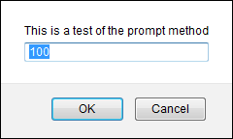
A statement that calls the prompt method with the object named omitted

Slide 24
One property of the window object

Slide 25
Two methods of the document object

Slide 26
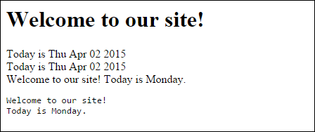
Write and writeIn statements in the body

Slide 27
Terms

Slide 28
Examples of number values

Slide 29
Terms

Slide 30
Common arithmetic operators

Slide 31
The order of precedence for arithmetic expressions

Slide 32
Examples of precedence and the use of parentheses

Slide 33
Terms

Slide 34
The most useful assignment operators

Slide 35
How to code compound assignment statements

Slide 36
Three ways to increment a counter variable

Slide 37
A floating-point result that isn’t precise

Slide 38
Terms

Slide 39
The concatenation operator for strings

Slide 40
Escape sequences that can be used in strings

Slide 41
How to declare string variables and assign values to them

Slide 42
How to code compound assignment statements

Slide 43
How escape sequences can be used in a string

Slide 44
How to declare Boolean variables and assign values to them

Slide 45
Terms

Slide 46
Two methods of the window object for working with numbers

Slide 47
Examples that use the parseInt and parseFloat methods

Slide 48
The same examples with the parse methods embedded in the alert method

Slide 49
Other examples of parse methods

Slide 50
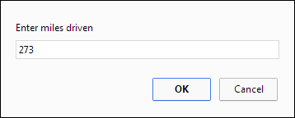
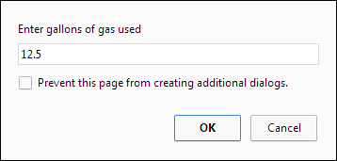
The dialog boxes for the Calculate MPG app

Slide 51
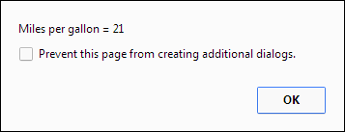
The dialog boxes for the Calculate MPG app (continued)

Slide 52
The HTML and JavaScript for the MPG app

Slide 53
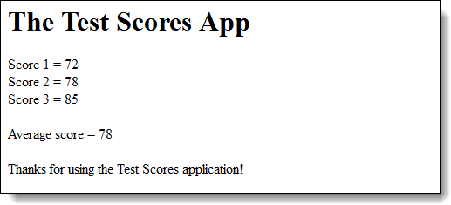
The results of the Test Scores app in a browser

Slide 54
The HTML and JavaScript for the Test Scores app

Slide 55
The HTML and JavaScript (continued)

Slide 56
Exercise 2-1 Modify the MPG application

Slide 57
Exercise 2-2 Create a simple application

Slide 58
Extra 2-1 Convert Fahrenheit to Celsius

Slide 59
Short 2-1 Modify the Test Scores application

